Slide 1
Optimised Singular Value Decomposition for Image Compression
Theory • Implementation • Evaluation
Presented by: Shivam Kumar
Roll No. : 2311166
Submitted to: Dr. Subhasish Basak

Slide 2
Why is compression needed?
To store data efficiently
To transmit data efficiently
To save:
Memory
Bandwidth
Cost

Slide 3
Introduction
• Digital images often contain redundant information
• Compression reduces file size while preserving quality
• Two approaches: lossless/reversible vs lossy/irreversible compression
• This project studies SVD-based lossy compression
• Integrates JPEG quantization for further size reduction

Slide 4
Information vs Data
REDUNDANT DATA
INFORMATION
DATA = INFORMATION + REDUNDANT DATA

Slide 5
How to compress?
Redundancies
Coding
Redundancy
Psycho-visual
Redundancy
Interpixel
Redundancy
This type of redundancy occurs when data is represented with inefficient code words.
Also called spatial redundancy.
Explored by predicting a pixel value based on neighbouring pixels
Exists due to psychophysical aspects
of human vision

Slide 6
Image Compression Techniques
Image compression techniques are of two types: Lossless and Lossy.
Lossless compression defines entropy and produces an identical copy of the original image.
Lossless techniques are reversible and do not degrade image quality.
Lossy compression removes details that the human eye cannot easily detect.
Lossy compression reduces storage by eliminating less noticeable features.
Lossy methods are irreversible because some image data is permanently lost.

Slide 7
Project Objectives
What is SVD?
Why SVD for image compression?
Methodology
Experiments & Metrics
Optimal k and jpeg_q
Conclusions

Slide 8
What is SVD?
Basic idea:
Taking a high dimensional, highly variable set of data points and reducing it to a lower dimensional space that exposes the substructure of the original data more clearly and orders it from most variation to the least.
Definition:
In linear algebra, the singular value decomposition is a factorization of a real or complex, square or non-square matrix. Consider a matrix A with m rows and n columns with rank r. Then A can be factorized into three matrices: A = U S Vᵀ

Slide 9
SVD
Diagrammatically:
A = [u₁ u₂ ... uₙ] × [σ₁ 0 ... 0 ] × [ v₁ᵀ ] [ 0 σ₂ ... 0 ] [ v₂ᵀ] [ . . . . ] [ . ] [ 0 0 ... σᵣ ] [ vₙᵀ ]
U is an m × m orthogonal matrix
Vᵀ is the conjugate transpose of the n × n orthogonal matrix
S is an m × n diagonal matrix with non‑negative real numbers
U contains left‑singular vectors, V contains right‑singular vectors
σ₁ ≥ σ₂ ≥ ... ≥ σᵣ are the singular values that appears in descending order along the diagonal of S.
The singular values satisfy σ₁² ≥ ... ≥ σᵣ² which are eigenvalues of AAᵀ and AᵀA)

Slide 10
SVD
SVD takes a matrix, square or non-square, and divides it into two orthogonal matrices and a diagonal matrix
Simply applying SVD on an image does not compress it
To compress an image, after applying SVD:
• Retain the first few singular values (maximum image info)
• Discard the lower singular values (negligible info)
The singular vectors form orthonormal bases
Important relation: A vᵢ = sᵢ uᵢ
Shows that each right singular vector corresponds to a left singular vector scaled by its singular value

Slide 11
Mathematical steps to calculate SVD of a matrix
Given an input image matrix A.
First, calculate A Aᵀ and Aᵀ A.
Use A Aᵀ to find the eigen values and eigenvectors to form the columns of U: (A Aᵀ - λI) x = 0.
Use Aᵀ A to find the eigen values and eigenvectors to form the columns of V: (Aᵀ A - λI) x = 0.
Divide each eigen vector by its magnitude to form the columns of U and V.
Take the square root of the eigenvalues to find the singular values, and arrange them in S in descending order: σ₁ ≥ σ₂ ≥ … ≥ σᵣ ≥ 0.

Slide 12
Storage Space Calculations
A = U S Vᵀ
A = Σᵢ σᵢ uᵢ vᵢᵀ
Aₖ = σ₁u₁v₁ᵀ + σ₂u₂v₂ᵀ + … + σᵣuᵣvᵣᵀ (Reconstructed A)
When performing SVD compression, the sum is not performed to the last singular values (SVs); small SVs are dropped.
Values outside required rank are set to zero.
Closest rank‑k matrix is obtained by truncating after first k terms:
Aₖ = σ₁u₁v₁ᵀ + σ₂u₂v₂ᵀ + … + σₖuₖvₖᵀ
Total storage for Aₖ:
Aₖ = k(m + n + 1)
Digital image Aₖ still resembles the original image closely.

Slide 13
Lowest rank‑k approximations
Since σ₁ > σ₂ > … > σₙ > 0, first terms impact the sum the most.
Matrix A can be approximated using only the first few terms.
Increasing k improves quality but increases storage.
Smaller rank‑k SVD approximations are preferable.
k must be limited so compressed image uses less space than original.
Necessary condition:
k < mn / (m + n + 1)

Slide 14
Compression Pipeline
1. Extract R, G, B matrices
2. Compute SVD on Red channel
3. Project G,B using V from R
4. Reconstruct and JPEG compress

Slide 15
How to Achieve that:
1) Split image into R, G, B
The image is converted to RGB and separated into three 2-D matrices.
SVD operates on matrices, so each channel needs its own matrix.
Channel separation preserves color structure and allows independent compression of each component.
2) Compute truncated SVD on the Red channel
Approximate SVD is applied only to the Red channel to extract its top-k singular values and vectors.
These vectors capture the major spatial patterns.
Using Red only makes the process ~3× faster.
3) Project Green & Blue using the same V basis
G and B are projected onto the V basis learned from Red.
Image channels are usually correlated, so Red’s structure approximates all channels.
This reduces computation while maintaining visual accuracy.

Slide 16
4) Reconstruct rank-k approximations of R, G, B
Using U * diag(S) * Vᵀ, each channel is rebuilt using only k dominant components.
This removes fine details and noise.
This reduces intrinsic dimensionality.
5) Save compressed image using JPEG
The reconstructed low-rank image is saved using JPEG.
SVD removes structural redundancy; JPEG removes perceptual redundancy.
Combined, they produce smaller file sizes.
6) Compute compression metrics
Original vs compressed size gives storage savings.
MSE and PSNR measure signal loss.
Used to judge k and jpeg_q.

Slide 17
FLOW CHART:
Load Image
Function: compress_to_jpeg()
Input: file path
Output: RGB image
Split Channels
Function: compress_to_jpeg()
Output: R, G, B matrices
Initialize V (Random Basis)
Function: svd_batch_fast() + lcgg()
Output: V (n×k)

Slide 18
Power Iteration SVD
Function: svd_batch_fast()
Subcalls: matmul_fast, transpose,
normalize_columns, gram_schmidt
Output: U_r, S_r, Vt
Project G & B onto V
Function: matmul_fast(G,V), matmul_fast(B,V)
Output: U_g, U_b
Scale Coefficients
Loop in compress_to_jpeg()
Output: scaled U_g, U_b
Reconstruct Rk,Gk,Bk
Function: reconstruct()
Output: rank-k channels

Slide 19
Pack & Clamp Image
Function: PIL Image.new()
Output: out image
JPEG Encode
Function: out.save(. JPEG)
Output: compressed file
Compute Metrics
Function: compute_metrics()
Output: CR, MSE, PSNR
Show Comparison
Function: show_comparison()
Output: visuals + prints

Slide 20
What SVD Compression Really Does
SVD = Mathematical Compression
SVD reduces an image matrix to a low-rank approximation.
Only top-k singular values and vectors are kept.
This removes redundant structure inside the image. Reduces interpixel redundancy.
It compresses the data mathematically (fewer parameters).
But the file size does NOT reduce:
U, S, Vᵀ must still be stored as large matrices.
So saving the image normally still produces a large file.

Slide 21
Why SVD Cannot Reduce File Size
SVD alone CANNOT do file compression because:
It does not quantize data.
It does not reduce bit depth.
It does not encode redundancies.
It outputs floating-point matrices which are large.
Conclusion:
SVD ≠ file compression
SVD = low-rank mathematical representation only

Slide 22
Why JPEG Is Needed After SVD
JPEG = Actual File Compression
Converts image to YCbCr.
Applies DCT on 8×8 blocks.
Quantizes coefficients.
Uses Huffman coding to shrink file size.
So in the pipeline:
SVD → removes structural redundancy
JPEG → removes perceptual + entropy redundancy
Therefore:
SVD compresses the matrix
JPEG compresses the file

Slide 23
Why Use SVD + JPEG Together?
JPEG alone compresses the file, but combining SVD + JPEG can give even better compression.
SVD reduces structural/computational redundancy by removing fine details and noise.
SVD smooths the image so JPEG finds more zeros after DCT → higher compression.
SVD reduces global image complexity before JPEG’s local block compression.
JPEG then removes perceptual and statistical redundancy efficiently.
Together they achieve stronger compression than either method alone.

Slide 24
Why Use SVD for Images?
Images have highly correlated pixel structure.
SVD preserves most energy with few components.
Acts as dimensionality reduction.

Slide 25
SVD Compression Measures:
Compression Ratio (CR):
CR = (Uncompressed Image Size) / (Compressed Image Size)
• Mean Square Error (MSE):
ᵐ ⁿ
MSE = (1 / (m·n)) · Σᵢ₌₁ Σⱼ₌₁ ( fA(xᵢ, yⱼ) − fAk̂(xᵢ, yⱼ) )²
• Peak Signal-to-Noise Ratio (PSNR):
PSNR = 10·log₁₀( MAX² / MSE )
= 20·log₁₀( MAX / √MSE )

Slide 26
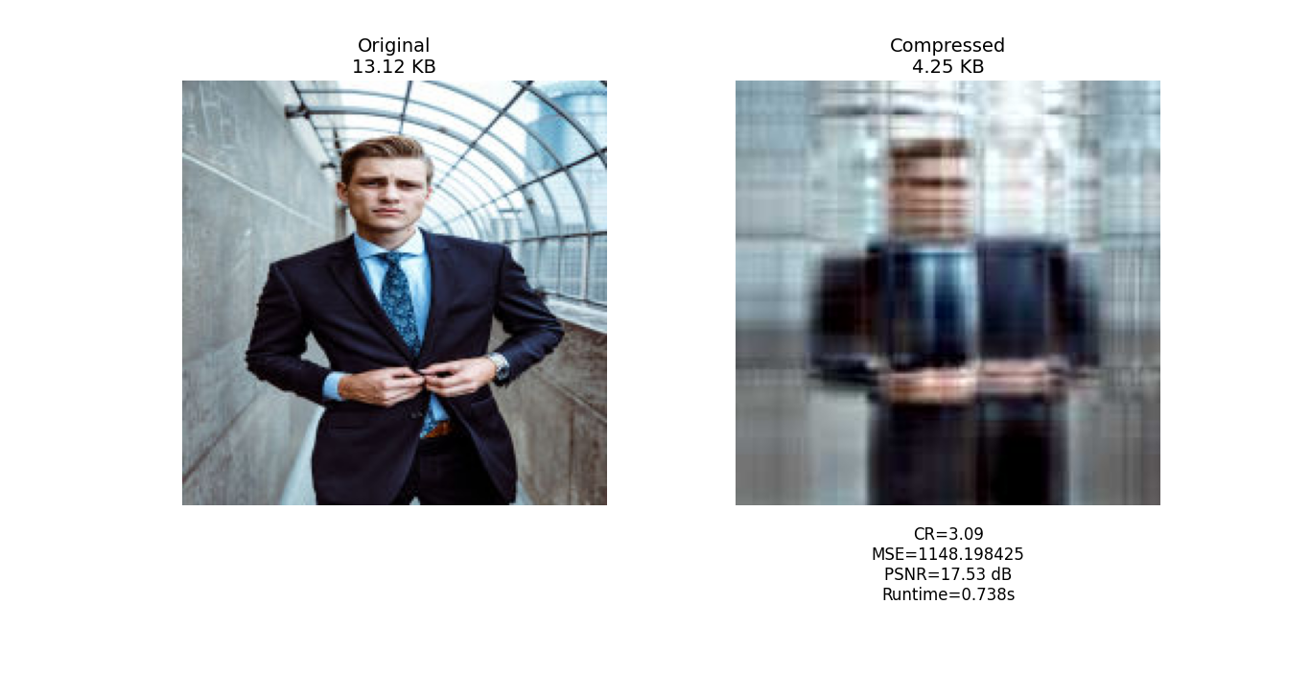
SVD Compressed Images for different K values
K = 5

Slide 27

K = 15

Slide 28
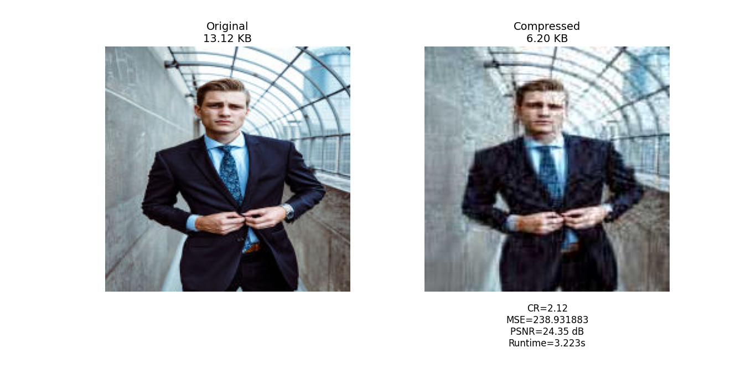
K = 30

Slide 29
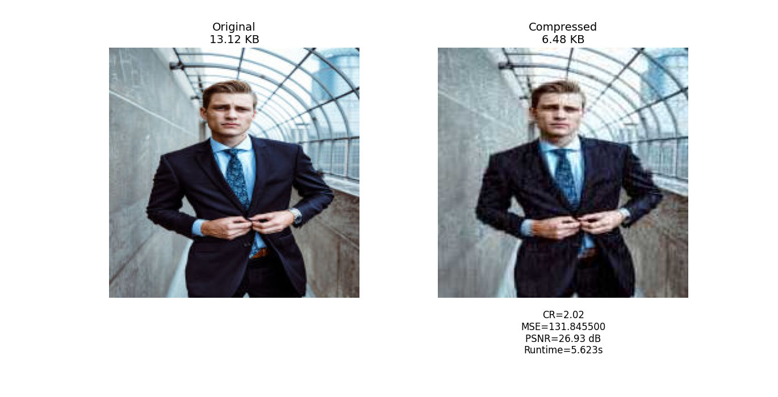
K = 50
K =

Slide 30
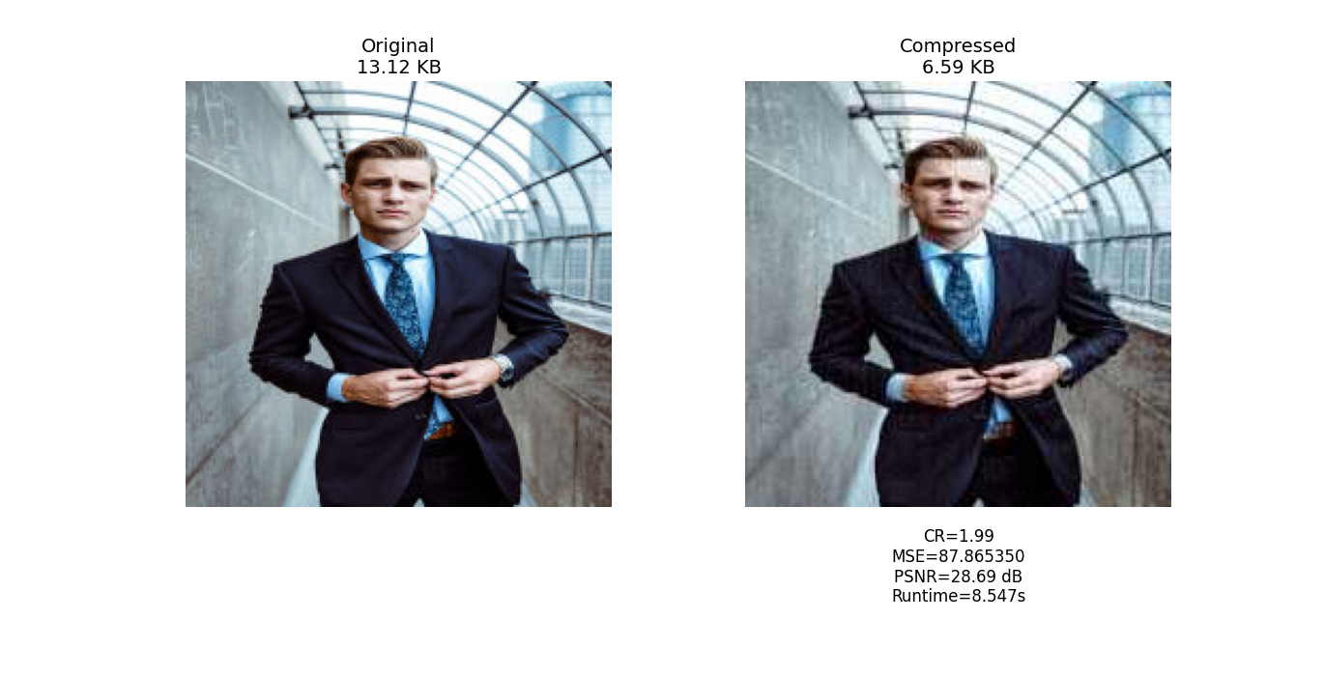
K = 80

Slide 31

K = 100

Slide 32

K = 100 jpeg quality= 60

Slide 33

K = 100 jpeg quality= 70

Slide 34

K = 100 jpeg quality= 80

Slide 35
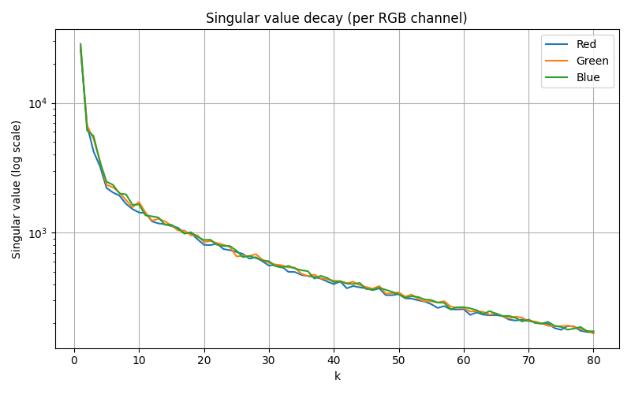
Plots

Slide 36
Energy Capture Analysis
• Energy = Σ (singular_value²)
• Cumulative energy curves show % of image preserved
• Useful for selecting initial range of k
• Typically 90–95% energy captured at small k

Slide 37
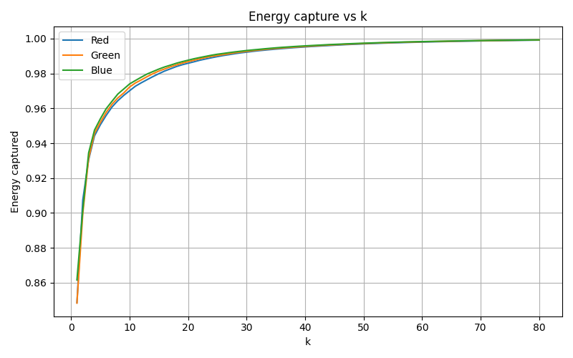

Slide 38
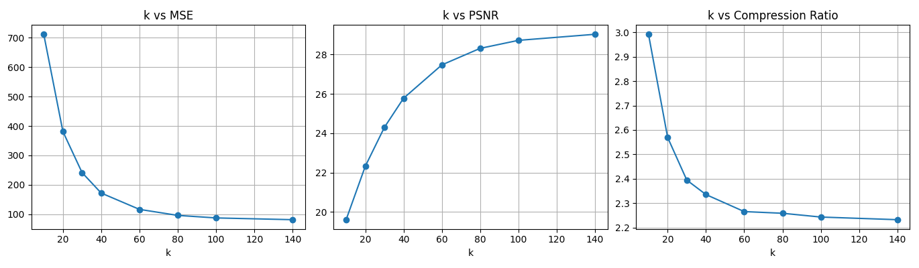

Slide 39
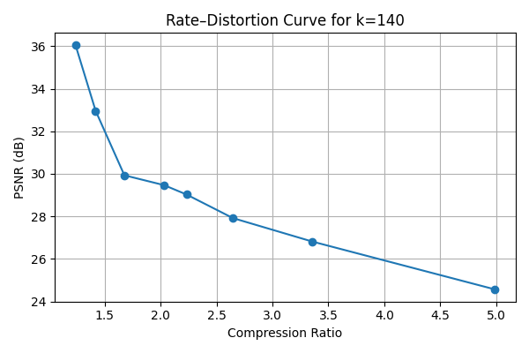

Slide 40
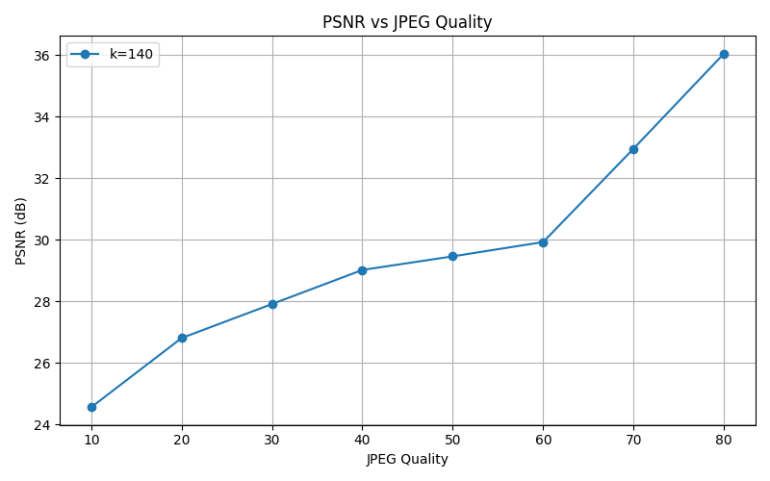

Slide 41
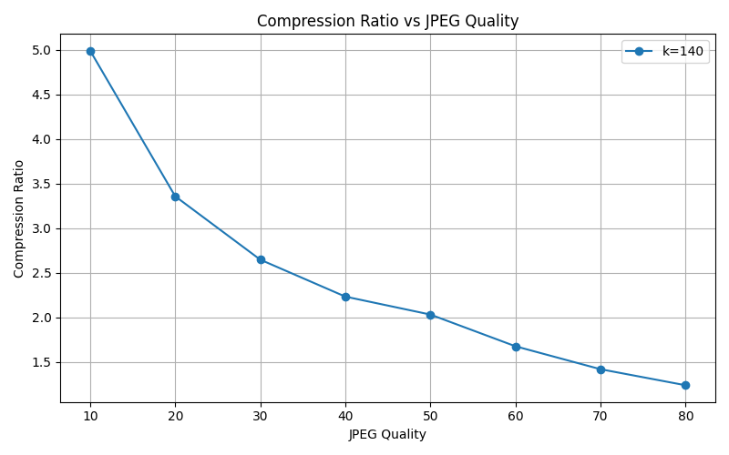

Slide 42
Optimal k Selection
• Defined PSNR gain threshold = 0.25 dB
• After threshold, improvements negligible
For JPEG quality fixed at 40:
• Algorithm selectes best_k automatically k = 140
• Helps balance compression and quality

Slide 43
Optimal Parameters
For k=140: recommended jpeg_q=80, PSNR=36.05 dB, CR=1.24, size=10.59 KB

Slide 44
Expected artifacts
Low k → blurring and texture loss.
Shared V basis may cause color shifts.
Low JPEG quality → blockiness, ringing.

Slide 45
Conclusion
SVD enables controllable lossy compression.
Higher k gives better quality but slower runtime.
JPEG quality greatly influences final size.
SVD provides mathematically elegant compression Low-rank structure of images exploited effectively
Hybrid SVD+JPEG yields high-quality, tiny files
Numerical results aligned with theoretical expectations
Future work: block-wise SVD

Slide 46
References:
R. Mukherjee and S. Chandran, "Lossy image compression using SVD coding, compressive autoencoders, and prediction error-vector quantization," 2017 4th International Conference on Opto-Electronics and Applied Optics (Optronix), Kolkata, India, 2017, pp. 1-5, doi:10.1109/OPTRONIX.2017.8349661.(https://ieeexplore.ieee.org/stamp/stamp.jsp?tp=&arnumber=8349661&isnumber=8349658)
Bag, Ayan. (2020). Lossy Image Compression Using Singular Value Decomposition And Fast Fourier Transform. 10.13140/RG.2.2.11305.62567.
Aishwarya, K. M. et al. “Lossy image compression using SVD coding algorithm.” 2016 International Conference on Wireless Communications, Signal Processing and Networking (WiSPNET) (2016): 1384-1389.

Slide 47
THANK YOU

